Slide 1

Growing As Children of Light
Notes:
This graphic came from Jason Hardin. I am certain have I have used notes from Mark Copeland’s EO series, Randy Yerby, Aaron Fleenor and other in making these powerpoints. Further, images have been used from the internet that remain property of their owners. This can not be sold or used commercially. It can only be used for classroom (Bible class) purposes.

Slide 2
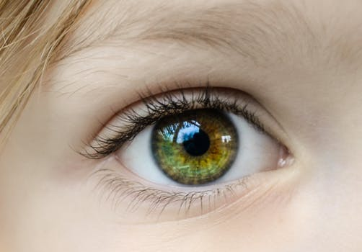

Eyeing Second Peter
Building On God’s Promises
Escaping the Corruption in the World
Partaking of the Divine Nature
Week 2

Slide 3
Memory Passage
2 Peter 1:3-4 According as his divine power hath given unto us all things that pertain unto life and godliness, through the knowledge of him that hath called us to glory and virtue: Whereby are given unto us exceeding great and precious promises: that by these ye might be partakers of the divine nature, having escaped the corruption that is in the world through lust.

Slide 4

Eyeing Second Peter
Weekly study plan:
Read 2 Peter once a week
Work on the memory verse by reading it carefully aloud at least eleven times this week
Any study on next weeks topic in the text from next week’s topic: Diligence

Slide 5
Three Mnemonics: Remembering Second Peter
1
Blindness and Myopia Control
Eyes Full of Adultery
Twinkling of an Eye
Holiness – Heresy – Hope
Cultivate Christian Character
Condemnation of false teachers
Confidence in Christ’s return
2
3

Slide 6


Escaping the Corruption in the World

Slide 7
Introduction
Corruption
“Ruin, destruction, dissolution, deterioration, corruption … of religious and moral depravity” AG 861
“Moral decay” Thayer 651
Having escaped corruption, we have an obligation to grow morally and spiritually.

Slide 8
Introduction: Escaping Corruption and Partaking of the Divine Nature
“The participation or sharing in the characteristics of deity needs to be exercised daily in life to bring about further spiritual growth and maturation.” Hamilton 32
“Without God’s work and his initiative in sending Christ and giving the word of God to create faith …, it would be impossible for man to be redeemed, but once God enables, man has the responsibility of walking in faith with the obedience that grows out if it … a Christian is not passive in his/her ultimate redemption. Having escaped experienced the forgiveness of sins and having become a sharer in the characteristics of deity, he has the obligation to be active in spiritual growth and development in the supplying of various qualities which are here going to be delineated by Peter.” Hamilton p.33-34
Humanity must apply faith to God’s grace

Slide 9
Introduction: Escaping Corruption
Lust eputhumia “desire, craving, longing’ (Thayer)
Verb form in Rom 13:9 “You shall not covet”
Lust
Corrupts 2 Peter 1:4
Wars against inner person Gal 5:16,17
Deceives Eph 4:22
Discontent Heb 13:5
Captivates Titus 3:3, Romans 6:12-3
Condemns James 1:18, Mt 5:29, Eph 2:3

Slide 10
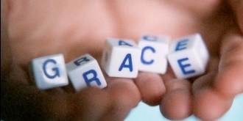
Juxtaposing Sin and Grace
Passions/desires, sin, and grace
Ephesians 2:1-10 (ESV) And you were dead in the trespasses and sins in which you once walked, following the course of this world, following the prince of the power of the air, the spirit that is now at work in the sons of disobedience— among whom we all once lived in the passions of our flesh, carrying out the desires of the body and the mind, and were by nature children of wrath, like the rest of mankind. But God, being rich in mercy, because of the great love with which he loved us, 5 even when we were dead in our trespasses, made us alive together with Christ—by grace you have been saved—6 and raised us up with him and seated us with him in the heavenly places in Christ Jesus, 7 so that in the coming ages he might show the immeasurable riches of his grace in kindness toward us in Christ Jesus. 8 For by grace you have been saved through faith. And this is not your own doing; it is the gift of God, 9 not a result of works, so that no one may boast. 10 For we are his workmanship, created in Christ Jesus for good works, which God prepared beforehand, that we should walk in them.
Why do folks so often take God’s grace for granted?

Slide 11
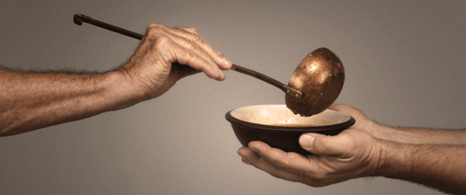
Grace Trains To Put Away Sin
Titus 2:11-14 (ESV) For the grace of God has appeared, bringing salvation for all people, 12 training us to renounce ungodliness and worldly passions, and to live self-controlled, upright, and godly lives in the present age, 13 waiting for our blessed hope, the appearing of the glory of our great God and Savior Jesus Christ, 14 who gave himself for us to redeem us from all lawlessness and to purify for himself a people for his own possession who are zealous for good works.

Slide 12
Lust Enslaves, Grace Trains To Put Away Sin (Titus continued)
Titus 3:3-7 For we ourselves were once foolish, disobedient, led astray, slaves to various passions and pleasures, passing our days in malice and envy, hated by others and hating one another. But when the goodness and loving kindness of God our Savior appeared, he saved us, not because of works done by us in righteousness, but according to his own mercy, by the washing of regeneration and renewal of the Holy Spirit, whom he poured out on us richly through Jesus Christ our Savior, so that being justified by his grace we might become heirs according to the hope of eternal life

Slide 13
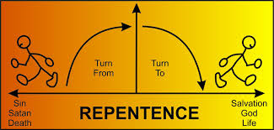
Repentance
Matthew 3:1-2 In those days John the Baptist came preaching in the wilderness of Judea, 2 “Repent, for the kingdom of heaven is at hand.”
Matthew 3:7-10 7 But when he saw many of the Pharisees and Sadducees coming to his baptism, he said to them, “You brood of vipers! Who warned you to flee from the wrath to come? 8 Bear fruit in keeping with repentance. 9 And do not presume to say to yourselves, `We have Abraham as our father,’ for I tell you, God is able from these stones to raise up children for Abraham.10 Even now the axe is laid to the root of the trees. Every tree therefore that does not bear good fruit is cut down and thrown into the fire.

Slide 14
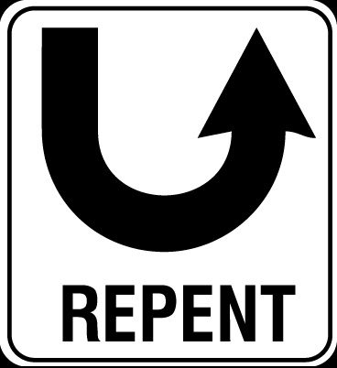
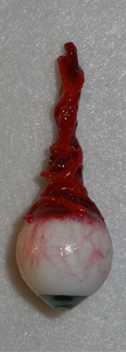
Jesus Taught Radical Repentance
Matthew 4:17 “Repent for the kingdom of heaven is at hand”
Mathew 18:8-9 “And if your hand or your foot causes you to sin, cut it off and throw it away. It is better for you to enter life crippled or lame than with two hands or two feet to be thrown into the eternal fire. And if your eye causes you to sin, tear it out and throw it away. It is better for you to enter life with one eye than with two eyes to be thrown into the hell of fire”

Slide 15
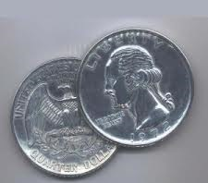
Romans 11:21-22 For if God spared not the natural branches, take heed lest he also spare not thee. Behold therefore the goodness and severity of God: on them which fell, severity; but toward thee, goodness, if thou continue in his goodness: otherwise thou also shalt be cut off.

Slide 16
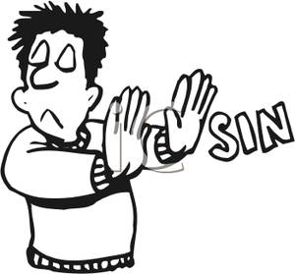
An Appeal To Put Away Sin
1 John 1:8-2:4 If we say that we have no sin, we deceive ourselves, and the truth is not in us. If we confess our sins, he is faithful and just to forgive us our sins, and to cleanse us from all unrighteousness. If we say that we have not sinned, we make him a liar, and his word is not in us. My little children, these things write I unto you, that ye sin not. And if any man sin, we have an advocate with the Father, Jesus Christ the righteous: And he is the propitiation for our sins: and not for ours only, but also for the sins of the whole world. And hereby we do know that we know him, if we keep his commandments. He that saith, I know him, and keepeth not his commandments, is a liar, and the truth is not in him.

Slide 17

An Appeal To Put Away Sin
1 John 3:1-8 Behold, what manner of love the Father hath bestowed upon us, that we should be called the sons of God: therefore the world knoweth us not, because it knew him not. Beloved, now are we the sons of God, and it doth not yet appear what we shall be: but we know that, when he shall appear, we shall be like him; for we shall see him as he is. And every man that hath this hope in him purifieth himself, even as he is pure. Whosoever committeth sin transgresseth also the law: for sin is the transgression of the law. And ye know that he was manifested to take away our sins; and in him is no sin. Whosoever abideth in him sinneth not: whosoever sinneth hath not seen him, neither known him. Little children, let no man deceive you: he that doeth righteousness is righteous, even as he is righteous. He that committeth sin is of the devil; for the devil sinneth from the beginning. For this purpose the Son of God was manifested, that he might destroy the works of the devil.

Slide 18
An Appeal To Put Away Sin
Romans 2:1-8 Therefore thou art inexcusable, O man, whosoever thou art that judgest: for wherein thou judgest another, thou condemnest thyself; for thou that judgest doest the same things. But we are sure that the judgment of God is according to truth against them which commit such things. And thinkest thou this, O man, that judgest them which do such things, and doest the same, that thou shalt escape the judgment of God? Or despisest thou the riches of his goodness and forbearance and longsuffering; not knowing that the goodness of God leadeth thee to repentance? But after thy hardness and impenitent heart treasurest up unto thyself wrath against the day of wrath and revelation of the righteous judgment of God; Who will render to every man according to his deeds: To them who by patient continuance in well doing seek for glory and honour and immortality, eternal life: But unto them that are contentious, and do not obey the truth, but obey unrighteousness, indignation and wrath

Slide 19
An Appeal To Put Away Sin
Jude 4 For there are certain men crept in unawares, who were before of old ordained to this condemnation, ungodly men, turning the grace of our God into lasciviousness, and denying the only Lord God, and our Lord Jesus Christ.

Slide 20
An Appeal To Put Away Sin
Hebrews 10:16-31This is the covenant that I will make with them after those days, saith the Lord, I will put my laws into their hearts, and in their minds will I write them; And their sins and iniquities will I remember no more. Now where remission of these is, there is no more offering for sin. Having therefore, brethren, boldness to enter into the holiest by the blood of Jesus, By a new and living way, which he hath consecrated for us, through the veil, that is to say, his flesh; And having an high priest over the house of God; Let us draw near with a true heart in full assurance of faith, having our hearts sprinkled from an evil conscience, and our bodies washed with pure water. Let us hold fast the profession of our faith without wavering; (for he is faithful that promised;) And let us consider one another to provoke unto love and to good works:

Slide 21
An Appeal To Put Away Sin
Hebrews 10:16-31 (continued) Not forsaking the assembling of ourselves together, as the manner of some is; but exhorting one another: and so much the more, as ye see the day approaching. For if we sin wilfully after that we have received the knowledge of the truth, there remaineth no more sacrifice for sins, But a certain fearful looking for of judgment and fiery indignation, which shall devour the adversaries. He that despised Moses' law died without mercy under two or three witnesses: Of how much sorer punishment, suppose ye, shall he be thought worthy, who hath trodden under foot the Son of God, and hath counted the blood of the covenant, wherewith he was sanctified, an unholy thing, and hath done despite unto the Spirit of grace? For we know him that hath said, Vengeance belongeth unto me, I will recompense, saith the Lord. And again, The Lord shall judge his people. It is a fearful thing to fall into the hands of the living God.

Slide 22
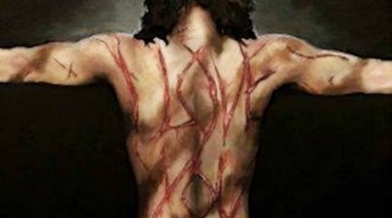
An Appeal To Put Away Sin
Please do not
”pervert the grace of our God into a license for immorality and deny Jesus Christ our only Sovereign and Lord” (Jude 4).
“presume on the riches of his kindness and forbearance and patience, not knowing that God’s kindness is meant to lead you to repentance” (Romans 2:4).
“go on sinning deliberately after receiving the knowledge of the truth,” because if you do, “there no longer remains a sacrifice for sins, but a fearful expectation of judgment, and a fury of fire that will consume the adversaries” (Hebrews 10:26-27).

Slide 23
An Appeal To Put Away Sin - Turning Back to Sin & False Teachers
2 Peter 2:20-22 For if after they have escaped the pollutions of the world through the knowledge of the Lord and Saviour Jesus Christ, they are again entangled therein, and overcome, the latter end is worse with them than the beginning. For it had been better for them not to have known the way of righteousness, than, after they have known it, to turn from the holy commandment delivered unto them. But it is happened unto them according to the true proverb, The dog is turned to his own vomit again; and the sow that was washed to her wallowing in the mire.

Slide 24
Escaping Corruption Abstain from Lust
2 Tim 2:22 “Flee youthful lusts”
James 4:7 “Resist the Devil and he will flee from you”
Col 3:1-4 “Set your mind on things above” (refocus your eyes on Jesus and the eternal)
Job 31:1-3 “I have made a covenant with my eyes”
1 Cor 15:58 “be steadfast, immovable, always abounding in the work of the Lord”

Slide 25
Escaping Corruption Abstain from Lust
Escaping corruption should be seen as happy and joyful – a benefit of obedience to Christ
Despite the putting away of sin, Christians still sin, yet live a life marked by obedience to Christ while bearing fruits of the Spirit. We can over come sin that has in the past beset us. We can escape the corruption and enslavement of sin.
Heb 3:13 But exhort one another every day, as long as it is called “today,” that none of you may be hardened by the deceitfulness of sin

Slide 26
Escaping Corruption Abstain from Lust
We can escape the corruption and enslavement of lust
2 Cor 10:3-5 “For though we walk in the flesh …”
Heb 12:1-2 Therefore, since we are surrounded by so great a cloud of witnesses, let us also lay aside every weight, and sin which clings so closely, and let us run with endurance the race that is set before us, looking to Jesus, the founder and perfecter of our faith, who for the joy that was set before him endured the cross, despising the shame, and is seated at the right hand of the throne of God.

Slide 27
Escaping Corruption Abstain from Lust
We can escape the corruption and enslavement of lust – Change ur thinking and focus
Romans 8:5 For those who live according to the flesh set their minds on the things of the flesh, but those who live according to the Spirit set their minds on the things of the Spirit
2 Cor 4:16-18So we do not lose heart. Though our outer self is wasting away, our inner self is being renewed day by day. For this light momentary affliction is preparing for us an eternal weight of glory beyond all comparison, as we look not to the things that are seen but to the things that are unseen. For the things that are seen are transient, but the things that are unseen are eternal.

Slide 28
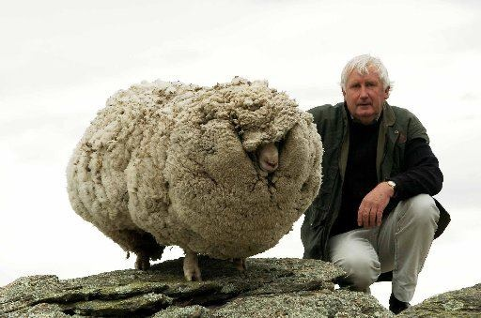
Shrek The Sheep & The Burden of Sin
Notes:
Burdened by sin. Enslaved and ruled by it?
The following as in article from Christians are us: This is Shrek the sheep. He became famous several years ago when he was found after hiding out in caves for six years. Of course, during this time his fleece grew without anyone there to shorn (shave) it. When he was finally found and shaved, his fleece weighed an amazing sixty pounds. Most sheep have a fleece weighing just under ten pounds, with the exception reaching fifteen pounds, maximum. For six years, Shrek carried six times the regular weight of his normal fleece… Simply because he was away from his shepherd.
This reminds me of John 10 when Jesus calls Himself a shepherd, and His followers are His sheep. Maybe it’s a stretch, but I think Shrek is much like a person who knows Jesus Christ as savior but has wandered. If we avoid Christ’s constant refining of our character, we’re going to accumulate extra weight in this world—a weight we don’t have to bear.
When Shrek was found, a professional sheep shearer took care of Shrek’s fleece in twenty-eight minutes. Shrek’s sixty pound fleece was finally removed. All it took was coming home to his shepherd and the shepherd took care of the rest.
Christ can lift the burdens we carry, if only we stop hiding. He can shave off our ‘fleece’—that is, our self-imposed burdens brought about by wandering from our Good Shepherd.
Matthew 11:28-30 “Come unto me, all ye that labour and are heavy laden, and I will give you rest. Take my yoke upon you, and learn of me; for I am meek and lowly in heart: and ye shall find rest unto your souls. For my yoke is easy, and my burden is light.”

Slide 29
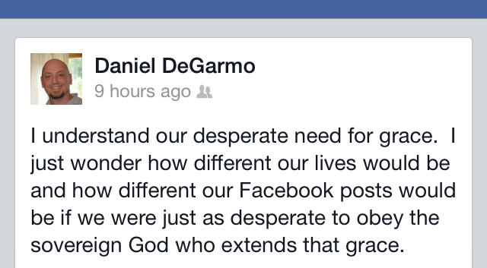

Slide 30
Sin and Grace: Putting It Together
Romans 5:8ff But God commendeth his love toward us, in that, while we were yet sinners, Christ died for us. Much more then, being now justified by his blood, we shall be saved from wrath through him. For if, when we were enemies, we were reconciled to God by the death of his Son, much more, being reconciled, we shall be saved by his life. And not only so, but we also joy in God through our Lord Jesus Christ, by whom we have now received the atonement. Wherefore, as by one man sin entered into the world, and death by sin; and so death passed upon all men, for that all have sinned: (For until the law sin was in the world: but sin is not imputed when there is no law. Nevertheless death reigned from Adam to Moses, even over them that had not sinned after the similitude of Adam's transgression, who is the figure of him that was to come. But not as the offence, so also is the free gift.

Slide 31
Sin and Grace: Putting It Together
Romans 5:8ff (continued) For if through the offence of one many be dead, much more the grace of God, and the gift by grace, which is by one man, Jesus Christ, hath abounded unto many. And not as it was by one that sinned, so is the gift: for the judgment was by one to condemnation, but the free gift is of many offences unto justification. For if by one man's offence death reigned by one; much more they which receive abundance of grace and of the gift of righteousness shall reign in life by one, Jesus Christ.) Therefore as by the offence of one judgment came upon all men to condemnation; even so by the righteousness of one the free gift came upon all men unto justification of life. For as by one man's disobedience many were made sinners, so by the obedience of one shall many be made righteous. Moreover the law entered, that the offence might abound. But where sin abounded, grace did much more abound: That as sin hath reigned unto death, even so might grace reign through righteousness unto eternal life by Jesus Christ our Lord.

Slide 32
Sin and Grace: Putting It Together
Romans 6:1-18 What shall we say then? Shall we continue in sin, that grace may abound? God forbid. How shall we, that are dead to sin, live any longer therein? Know ye not, that so many of us as were baptized into Jesus Christ were baptized into his death? Therefore we are buried with him by baptism into death: that like as Christ was raised up from the dead by the glory of the Father, even so we also should walk in newness of life. For if we have been planted together in the likeness of his death, we shall be also in the likeness of his resurrection: Knowing this, that our old man is crucified with him, that the body of sin might be destroyed, that henceforth we should not serve sin. For he that is dead is freed from sin. Now if we be dead with Christ, we believe that we shall also live with him: Knowing that Christ being raised from the dead dieth no more; death hath no more dominion over him.

Slide 33
Sin and Grace: Putting It Together
Romans 6:1-18 (continued) For in that he died, he died unto sin once: but in that he liveth, he liveth unto God. Likewise reckon ye also yourselves to be dead indeed unto sin, but alive unto God through Jesus Christ our Lord. Let not sin therefore reign in your mortal body, that ye should obey it in the lusts thereof. Neither yield ye your members as instruments of unrighteousness unto sin: but yield yourselves unto God, as those that are alive from the dead, and your members as instruments of righteousness unto God. For sin shall not have dominion over you: for ye are not under the law, but under grace. What then? shall we sin, because we are not under the law, but under grace? God forbid. Know ye not, that to whom ye yield yourselves servants to obey, his servants ye are to whom ye obey; whether of sin unto death, or of obedience unto righteousness? But God be thanked, that ye were the servants of sin, but ye have obeyed from the heart that form of doctrine which was delivered you. Being then made free from sin, ye became the servants of righteousness.

Slide 34
Next Week
Diligence

